Slide 1

Online Shoppers Purchasing Intention

Slide 2
Overview
Dataset Info
Data Preprocessing
Feature Selection and Clustering
Model Evaluation

Slide 3
Dataset Info
Contains information about wether a customer ended up making an online purchase or not.
12,330 Data Points
18 Columns (10 numerical and 8 categorical)
No missing values

Slide 4
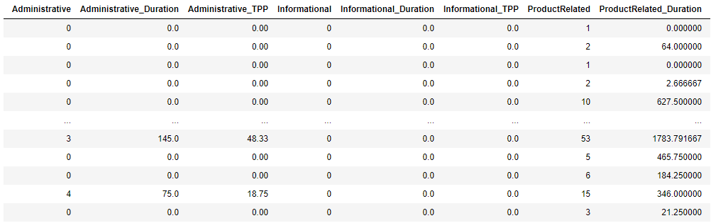

Data Preprocessing
Create new columns which result from a division between Duration and PageViews

Slide 5
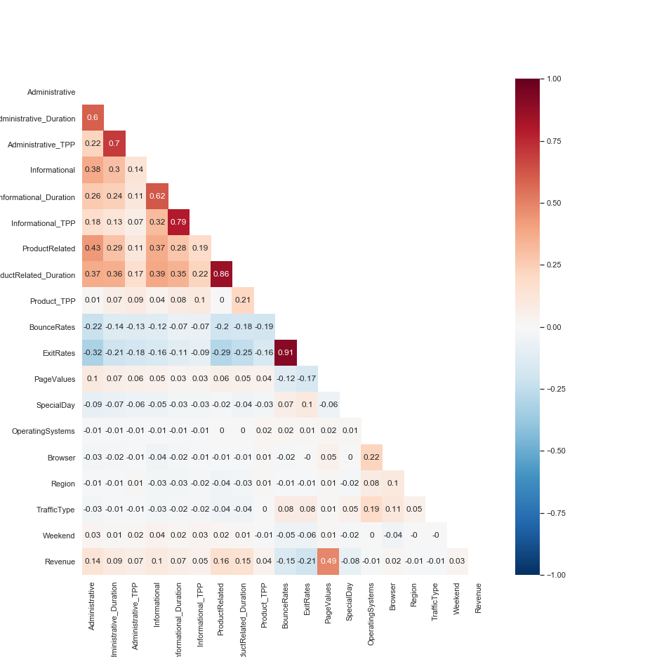
Data Preprocessing
Drop columns with high correlation
Columns chosen to drop: ExitRates

Slide 6
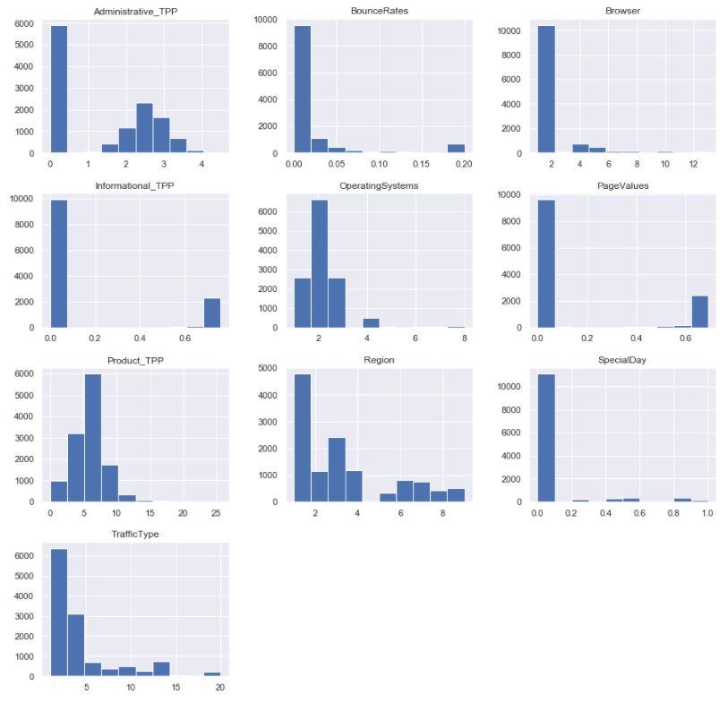
Data Preprocessing
Manage outliers and variables with different scales
Box-Cox method

Slide 7
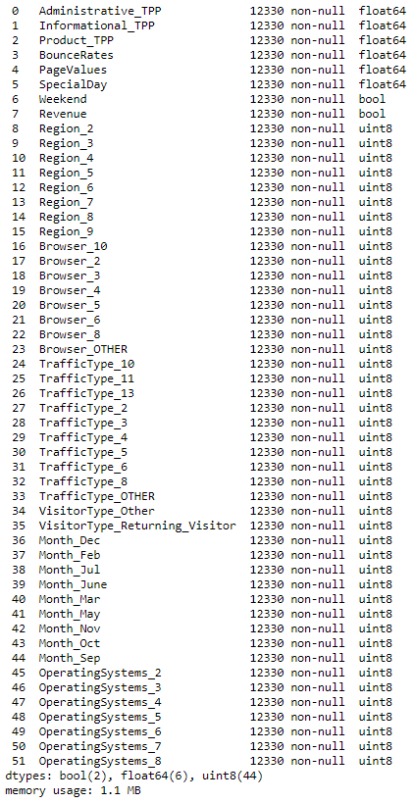
Data Preprocessing
Create dummies for the Categorical Columns
Month
TrafficType
OperatingSystems
Browser
Region
VisitorType
Final Result: 52 columns

Slide 8
Feature Selection and Clustering
Feature Selection
ANOVA f-test
10 columns chosen
PCA
19 principal components
Clustering
K-means
5 clusters chosen
41 columns used for clustering
80% Explained Variance

Slide 9

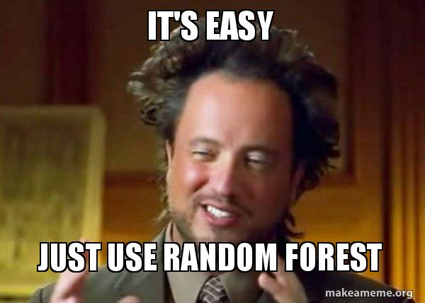
Model Evaluation Training the models
Methods used:
Stratified training and test split;
Over and Undersampling;
Cross-validation (RepeatedStratifiedKFold);
HyperParameter Tuning

Slide 10

Model Evaluation Random Forest
Hyper Tuned Cross-Validated Model
Baseline Model
Accuracy: 89%
Precision: 63%
Recall: 68%
AUC: 91%
Accuracy: 90%
Precision: 72%
Recall: 56%
AUC: 91%
TN 2419 | FN 152
FP 187 | TP 325
TN 2500 | FN 211
FP 106 | TP 266

Slide 11
What I learned
E-Commerce KPIs
How to manipulate Cross-Validation
Using PCA and TSNE
Understanding the parameters for hyperparameter tunning
Challenges
Handling Outliers
Improving the models
Understanding how cross-validation works
What I would have done differently
Consider dropping the outliers
Choose a different feature selection method

Slide 12

THANK YOU FOR YOUR ATTENTION!

